Slide 1
Traversal in BST
Saman Atif SP22-BCS-070

Slide 2
Tree Traversal
The term ‘tree traversal’ means traversing or visiting each node of a tree.
It performs functions like checking the node for data or updating the node.
Classification:
There are two common classifications for tree traversal algorithm:
Breadth first traversal
Depth first traversal

Slide 3
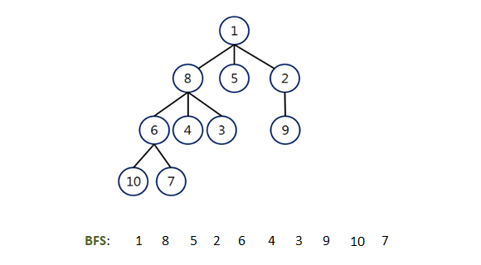
Breadth First Traversal
prints all the nodes of a tree level by level.
also called as Level order traversal
Application:
It can be used to find a spanning tree.
It is used in peer-to-peer Networks.

Slide 4
Depth first traversal:
There are three types of depth first traversal
Pre order traversal
Post order traversal
Inorder traversal

Slide 5
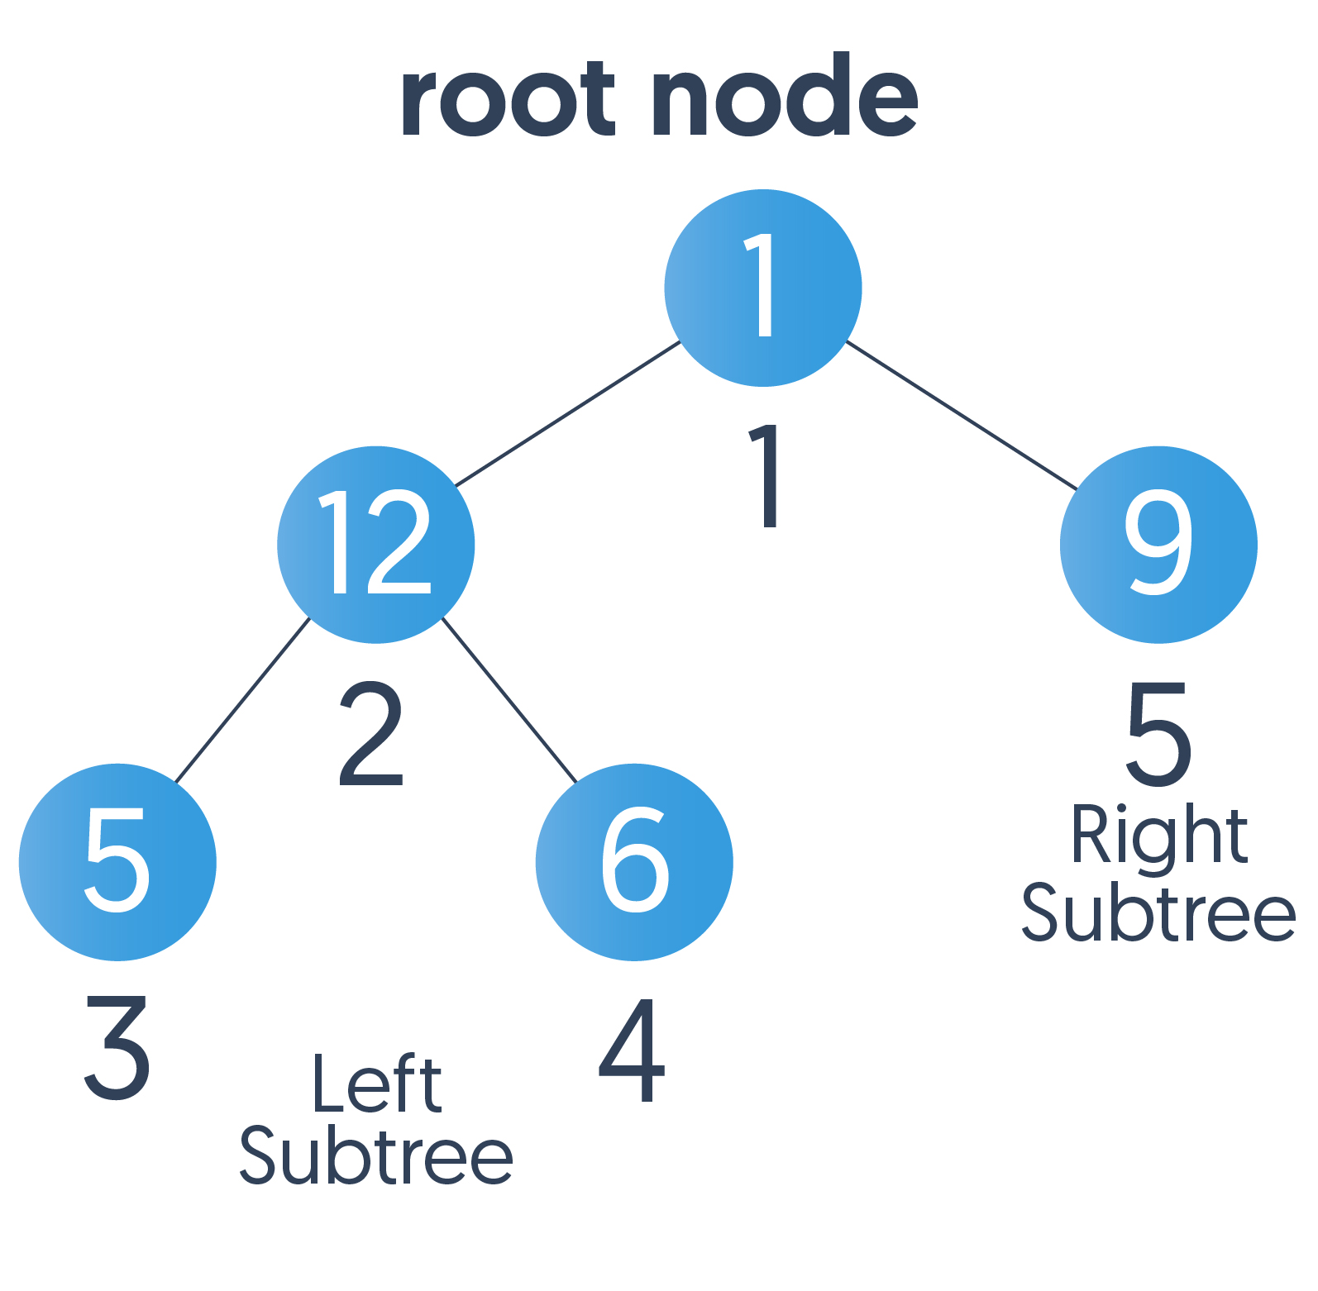
Pre-order Traversal
Vsit the root node.
Traverse the left subtree recursively.
Traverse the right subtree recursively.
Root → Left → Right

Slide 6
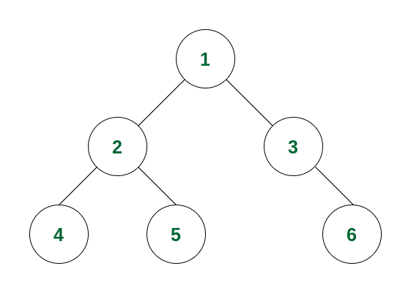
For Example
1,2,4,5,3,6

Slide 7
Applications of Pre-order traversal
Used to find Prefix expression.
Copy of a tree
BST construction
Decision tree traversal in machine learning

Slide 8
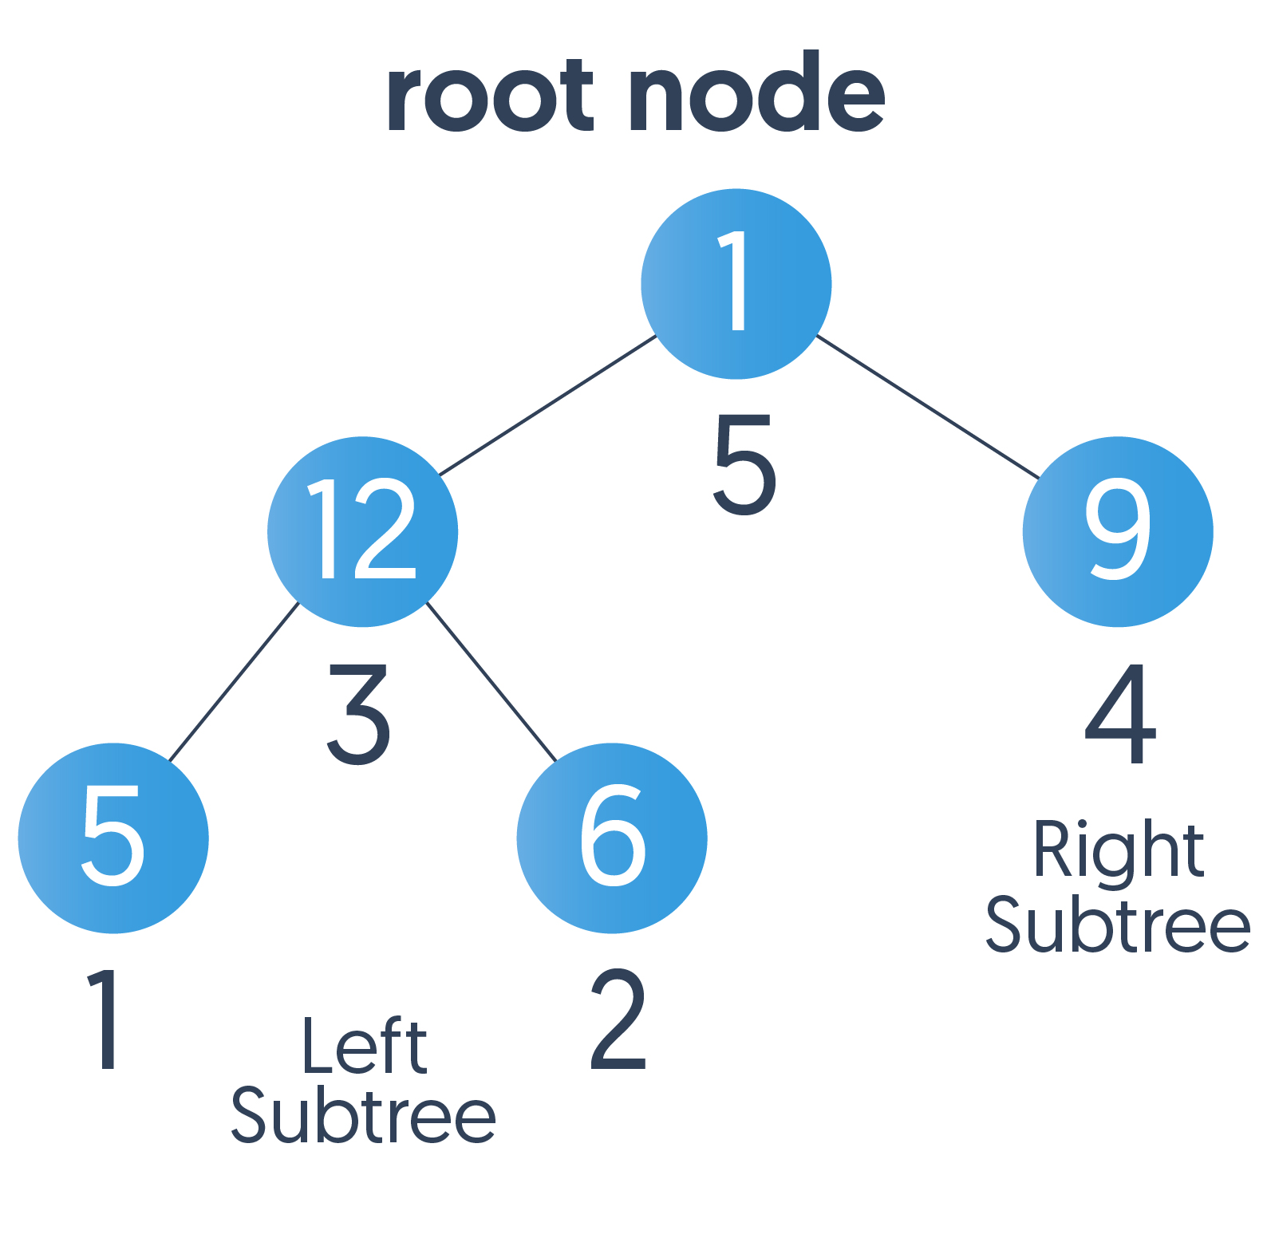
Post-order traversal
Traverse the left subtree recursively.
Traverse the right subtree recursively.
Visit the root node.
Root → Left → Right

Slide 9
For Example:
4,5,2,6,3,1

Slide 10
Applications of Post-order traversal
Deleting nodes in BT
To get the postfix expression
Code generation in compilers
Mathematical evaluation and parsing

Slide 11
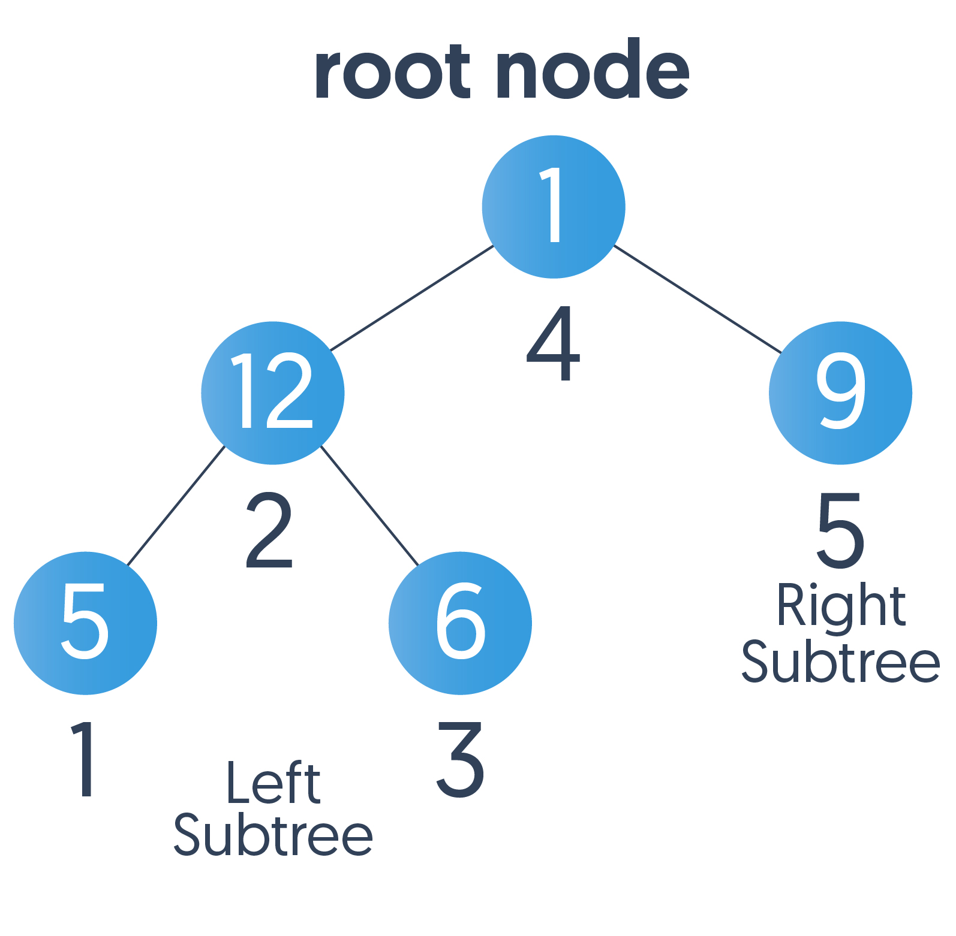
Inorder Traversal
Traverse the left subtree.
Visit the root.
Traverse the right subtree.
Left → Root → Right
Application
used to get infix expression of an expression tree.

Slide 12
For Example
4,5,2,1,3,6

